Slide 1

CHAPTER 9
COUNTING AND PROBABILITY
Copyright © Cengage Learning. All rights reserved.

Slide 2

9.4
The Pigeonhole Principle
Copyright © Cengage Learning. All rights reserved.

Slide 3
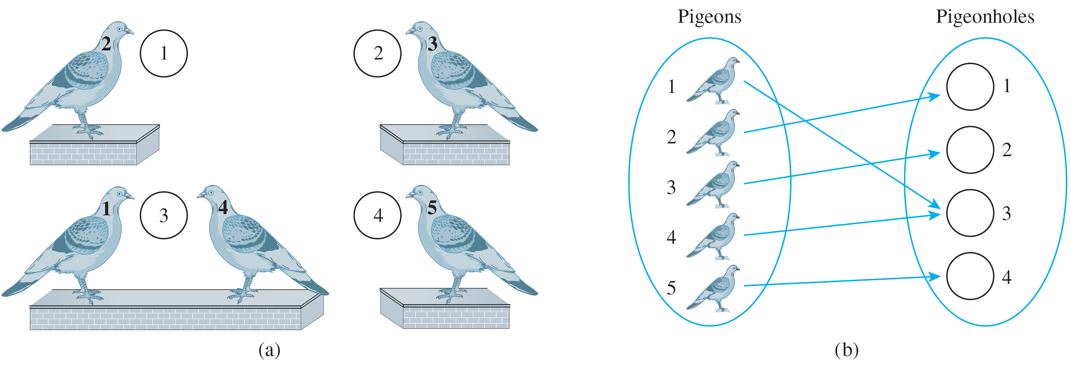
The Pigeonhole Principle
The pigeonhole principle states that if n pigeons fly into m pigeonholes and n > m, then at least one hole must contain two or more pigeons. This principle is illustrated in Figure 9.4.1 for n = 5 and m = 4.
Figure 9.4.1

Slide 4
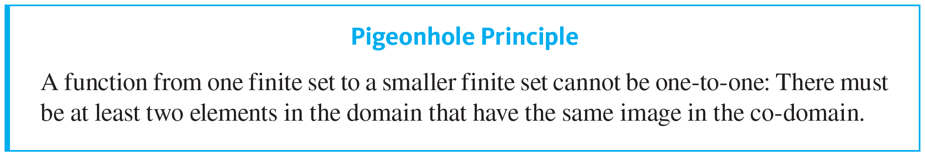
The Pigeonhole Principle
Illustration (a) shows the pigeons perched next to their holes, and (b) shows the correspondence from pigeons to pigeonholes. The pigeonhole principle is sometimes called the Dirichlet box principle because it was first stated formally by J. P. G. L. Dirichlet (1805–1859).

Slide 5
Example 9.4.1 – Applying the Pigeonhole Principle
a. In a group of six people, must there be at least two who were born in the same month? In a group of thirteen people, must there be at least two who were born in the same month? Why?
b. Among the residents of New York City, must there be at least two people with the same number of hairs on their heads? Why?

Slide 6
Example 9.4.1 – Solution
a. A group of six people need not contain two who were born in the same month. For instance, the six people could have birthdays in each of the six months January through June.
A group of 13 people, however, must contain at least two who were born in the same month, for there are only 12 months in a year and 13 > 12.
To get at the essence of this reasoning, think of the thirteen people as the pigeons and the twelve months of the year as the pigeonholes.

Slide 7
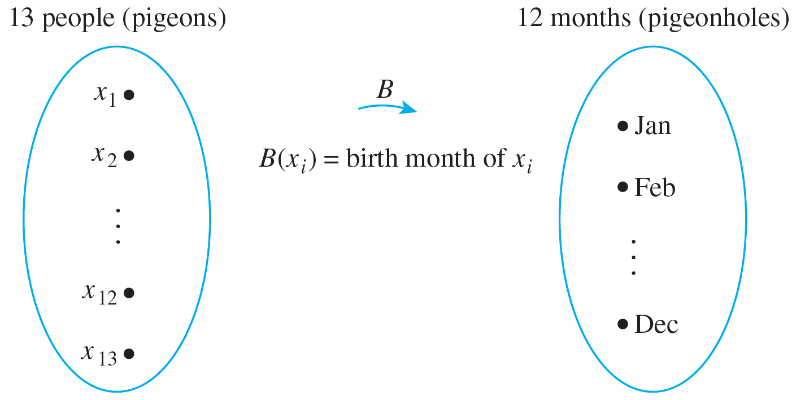
Example 9.4.1 – Solution
continued
Denote the thirteen people by the symbols x₁, x₂, … , x₁₃ and define a function B from the set of people to the set of twelve months as shown in the following arrow diagram.

Slide 8
Example 9.4.1 – Solution
continued
The pigeonhole principle says that no matter what the particular assignment of months to people, there must be at least two arrows pointing to the same month. Thus at least two people must have been born in the same month.
b. The answer is yes. In this example the pigeons are the people of New York City and the pigeonholes are all possible numbers of hairs on any individual’s head.
Call the population of New York City P. It is known that P is at least 8,000,000.

Slide 9
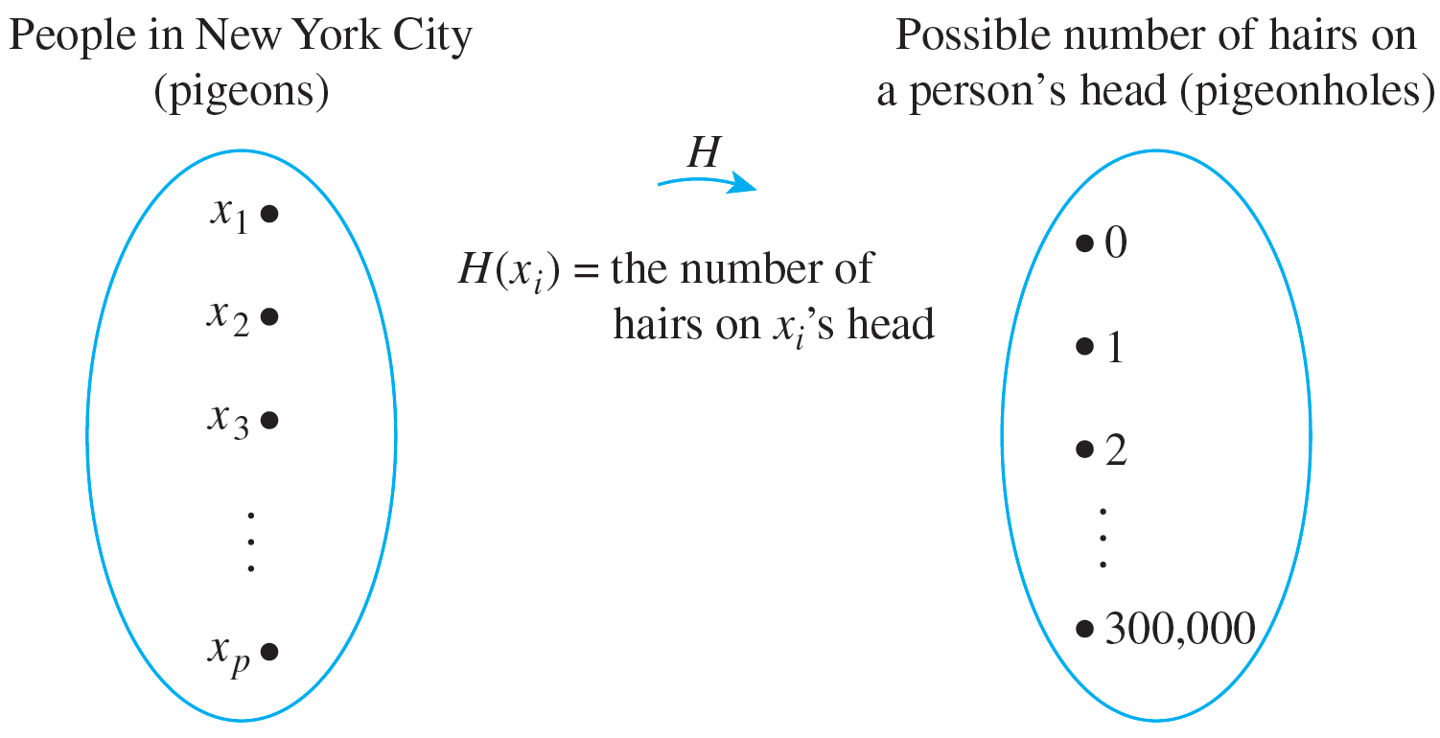
Example 9.4.1 – Solution
continued
Also, the maximum number of hairs on any person’s head is known to be less than 300,000. Define a function H from the set of people in New York City {x₁, x₂, … , x _{p}} to the set {0, 1, 2, 3, … , 300,000}, as shown in the arrow diagram.

Slide 10
Example 9.4.1 – Solution
continued
Since the number of people in New York City is larger than the number of possible hairs on their heads, the function H is not one-to-one; at least two arrows point to the same number. And this means that at least two people have the same number of hairs on their heads.

Slide 11
Application to Decimal Expansions of Fractions

Slide 12

Application to Decimal Expansions of Fractions
One important consequence of the pigeonhole principle is the fact that
the decimal expansion of any rational number either terminates or repeats.
A terminating decimal is one like 3.625, and a repeating decimal is one like
where the bar over the digits 246 means that these digits are repeated forever.

Slide 13
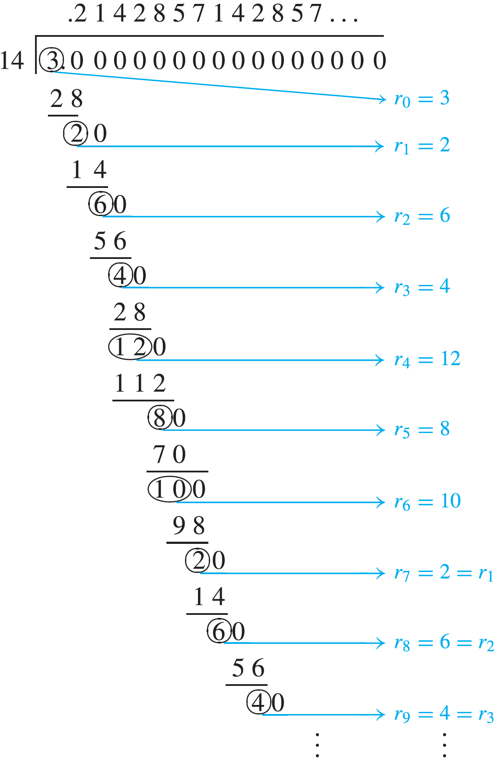
Example 9.4.4 – The Decimal Expansion of a Fraction
Let a and b be integers and consider a fraction a ∕ b, where for simplicity a and b are both assumed to be positive.
The decimal expansion of a ∕ b is obtained by dividing a by b as illustrated here for a = 3 and b = 14.

Slide 14
Example 9.4.4 – The Decimal Expansion of a Fraction
continued
Let r₀ = a and let r₁, r₂, r₃, … be the successive remainders obtained in the long division of a by b. By the quotient-remainder theorem, each remainder must be between 0 and b − 1.
(In this example, a is 3 and b is 14, and so the remainders are from 0 to 13.) If some remainder r _{i} = 0, then the division terminates and a ∕ b has a terminating decimal expansion. If no r _{i} = 0, then the division process and hence the sequence of remainders continues forever.

Slide 15
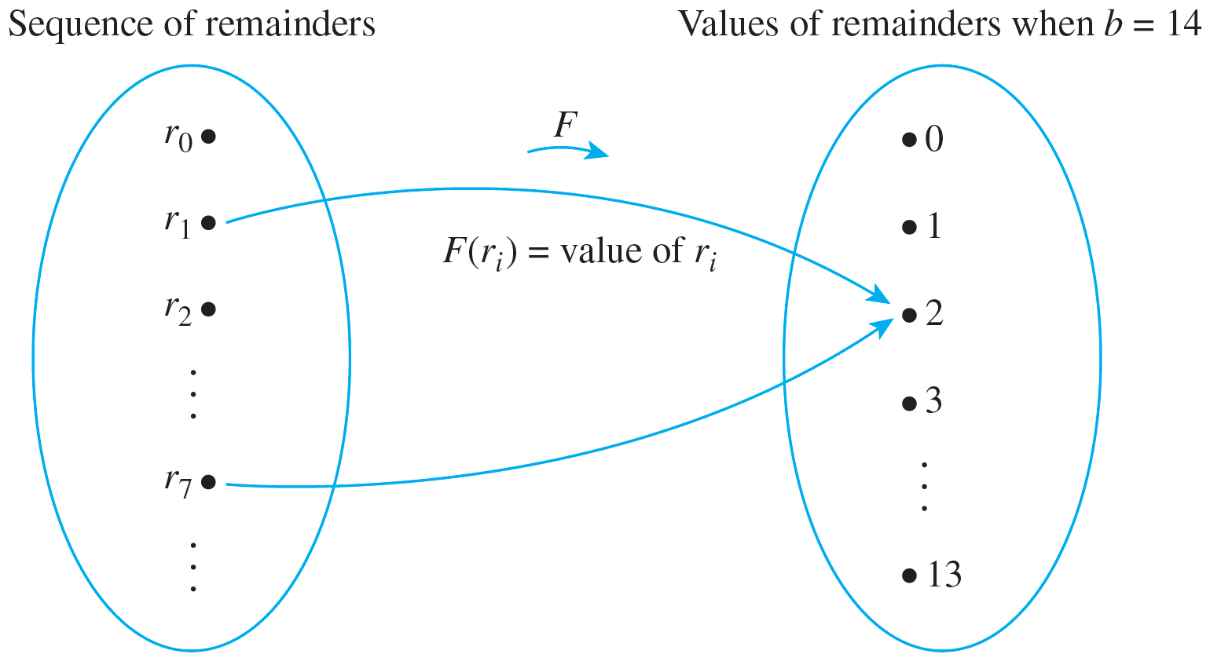
Example 9.4.4 – The Decimal Expansion of a Fraction
continued
By the pigeonhole principle, since there are more remainders than values that the remainders can take, some remainder value must repeat: r _{j} = r _{k}, for some indices j and k with j < k. This is illustrated below for a = 3 and b = 14.

Slide 16

Example 9.4.4 – The Decimal Expansion of a Fraction
continued
If follows that the decimal digits obtained from the divisions between r _{j} and r _{k − 1} repeat forever.
In the case of 3 ∕ 14, the repetition begins with r₇ = 2 = r _{i} and the decimal expansion repeats the quotients obtained from the divisions from r₁ through r₆ forever:

Slide 17
Generalized Pigeonhole Principle

Slide 18
Generalized Pigeonhole Principle
A generalization of the pigeonhole principle states that if n pigeons fly into m pigeonholes and, for some positive integer k, km < n, then at least one pigeonhole contains k + 1 or more pigeons.

Slide 19
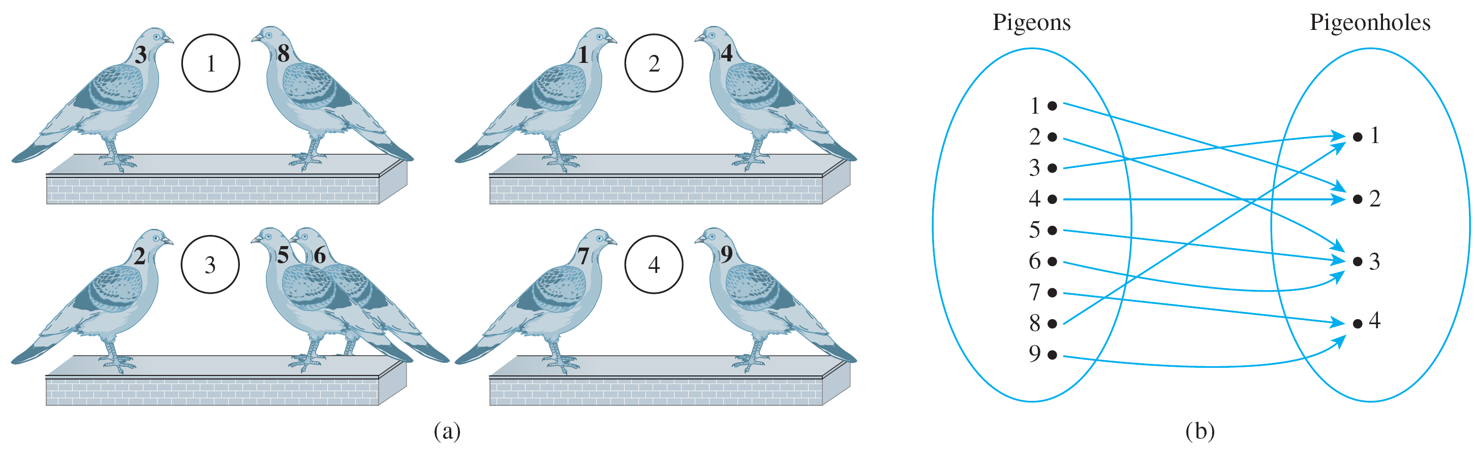
Generalized Pigeonhole Principle
This is illustrated in Figure 9.4.2 for m = 4, n = 9, and k = 2.
Figure 9.4.2
Since 2 · 4 < 9, at least one pigeonhole contains three (2 + 1) or more pigeons. (In this example, pigeonhole 3 contains three pigeons.)

Slide 20
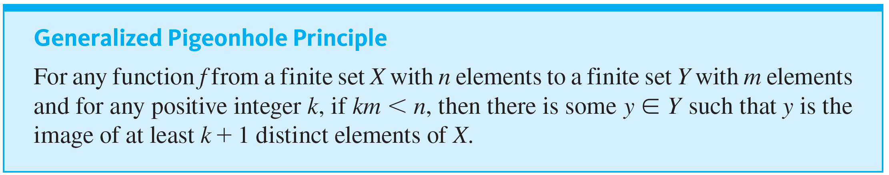
Generalized Pigeonhole Principle

Slide 21
Example 9.4.5 – Applying the Generalized Pigeonhole Principle
Show how the generalized pigeonhole principle implies that in a group of 85 people, at least 4 must have the same last initial.

Slide 22
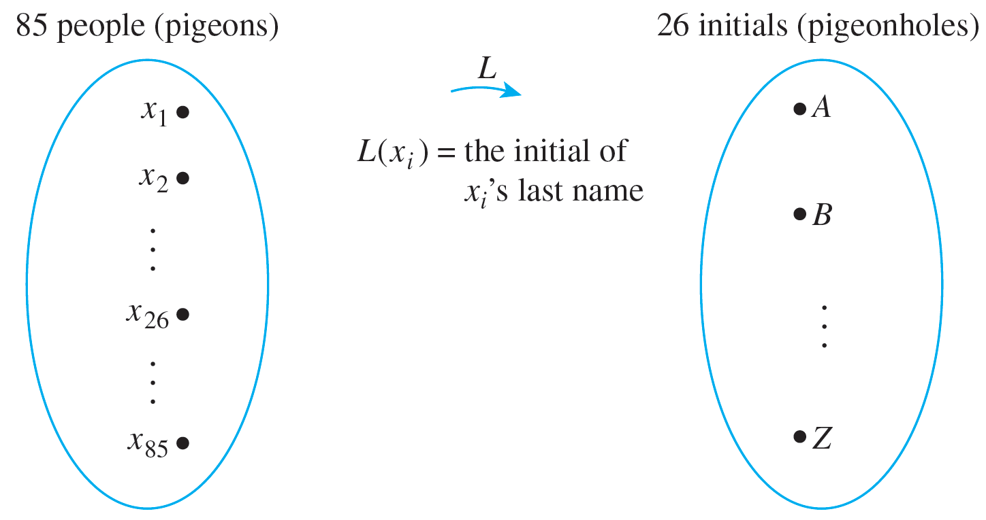
Example 9.4.5 – Solution
In this example the pigeons are the 85 people and the pigeonholes are the 26 possible last initials of their names.
Consider the function L from people to initials defined by the following arrow diagram.

Slide 23
Example 9.4.5 – Solution
continued
Since 3 · 26 = 78 < 85, the generalized pigeonhole principle states that some initial must be the image of at least four (3 + 1) people. Thus at least four people have the same last initial.

Slide 24
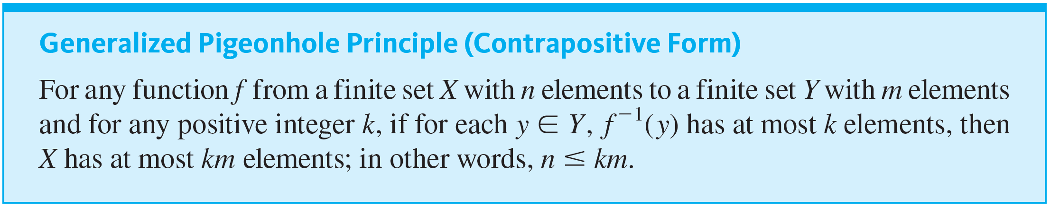
Generalized Pigeonhole Principle
Consider the following contrapositive form of the generalized pigeonhole principle.

Slide 25
Proof of the Pigeonhole Principle

Slide 26
Proof of the Pigeonhole Principle
The truth of the pigeonhole principle depends essentially on the sets involved being finite. We know that a set is called finite if, and only if, it is the empty set or there is a one-to-one correspondence from {1, 2, … , n} to it, where n is a positive integer.
In the first case the number of elements in the set is said to be 0, and in the second case it is said to be n. A set that is not finite is called infinite.

Slide 27
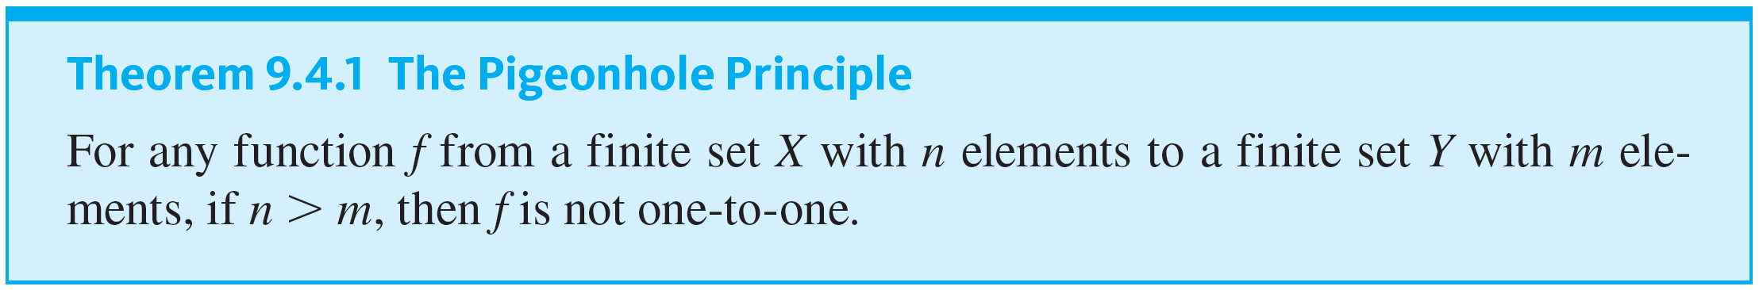
Proof of the Pigeonhole Principle
Thus any finite set is either empty or can be written in the form {x₁, x₂, … , x _{n}} where n is a positive integer.

Slide 28
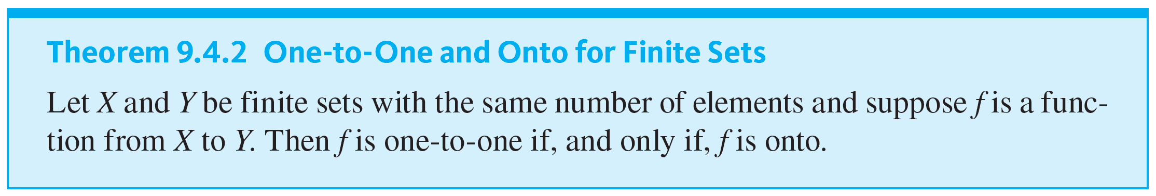
Proof of the Pigeonhole Principle
An important theorem that follows from the pigeonhole principle states that a function from one finite set to another finite set of the same size is one-to-one if, and only if, it is onto.
This result does not hold for infinite sets.

